Slide 1
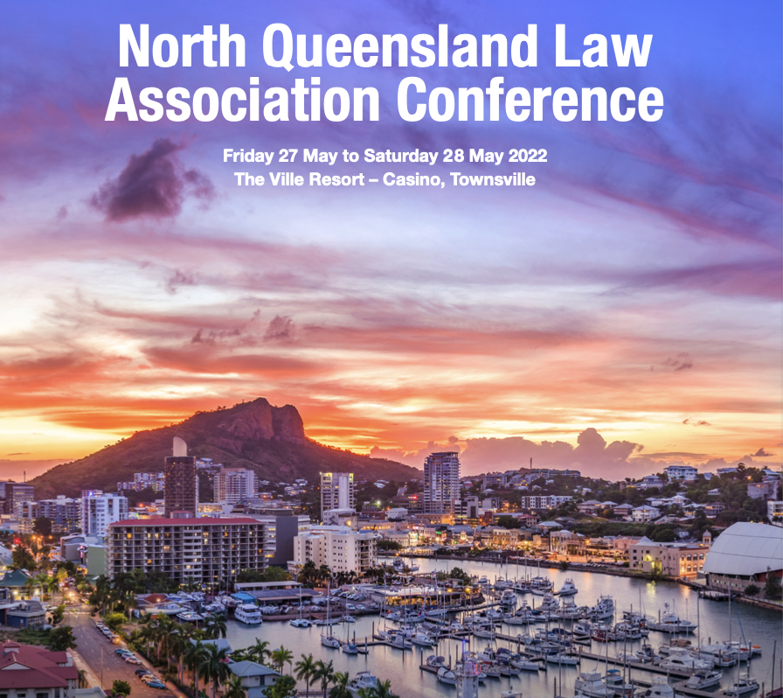
Appellate Challenge to Protection Orders Judge Dean P Morzone QC with Claire Grant Barrister-at-Law & Deanna Musumeci Barrister-at-Law

Slide 2
Know the mode & scope of appeal
Appeal to the District Court of Queensland.
By s 168(1) appeal must be decided on the evidence and proceedings before Magistrates Court, but s 168(2) reposes discretion heainrg afresh in whole or in part.
Not a new trial , appellate courts generally tolerate new points.
More broadly, requirements and limitations Fox v Percy (2003) 214 CLR 118 at [23].
The appeal court may:
confirm the decision; or
vary the decision; or
set aside decision and substitute another; or
set aside the decision and remit.

Slide 3
Framing the appeal
Yes …. preparation, preparation, preparation.
Errors of law, of fact or in the exercise of discretion to make a protection order.
Advocate’s careful and judicious scrutiny of the jurisdictional, factual, and legal foundations to develop the case theory of why the protection order warrants serious challenge.
Settling the grounds of :
Exactly identify the nature of the error.
Precisely particularise the error, and where it is made.
Analyse why the reasoning is erroneous and how it leads to the outcome sought.
Seize only on arguable and appropriate grounds; discard minor inconsequential errors.
Refine, simplify, and concisely express each appeal ground.

Slide 4
Legal Principles
Interrogate the decision and evidence to find relevant and consequential legal errors, for eg:
Did the magistrate interpret or apply the right statutory provision?
Did the magistrate interpret or apply the right legal principles?
Did the magistrate mislead or misguide herself/himself in the proper exercise of discretion in making the order?
Three pre-requisite matters of jurisdiction, fact and law, in exercising the discretion to make a protection order:
Is there a relevant relationship between the aggrieved and the respondent, namely: an intimate personal relationship, a family relationship, or an informal care relationship?
Has the respondent committed domestic violence against the aggrieved (including an associated person)?
Is a protection order necessary or desirable to protect the aggrieved from domestic violence?
Proof to the requisite standard the balance of probabilities, and considerations drawn from Briginshaw v Briginshaw .

Slide 5
“Necessary or Desirable”
Prospective judgment.
Focus on paramount need to protect an aggrieved from domestic violence, and whether imposing a protection order is necessary or desirable to meet that need.
Involves a risk assessment of the prospective risk and the need for protection against future domestic violence from that risk.
Must be more than a mere possibility or speculation of the prospect of domestic violence.
But, unlike the former Act, not “likelihood” of future domestic violence.
The three-stage process identified in MDE v MLG & Queensland Police Service [2015] QDC 151, a helpful litmus test to expose appealable error.

Slide 6
Did the magistrate err in assessing the risk of future domestic violence between the parties in the absence of any order?

Slide 7
Examine nature, patterns and propensity to particular conduct
circumstances of events
frequency and persistence
recent and relevant to present circumstances and arrangements
isolated or repetitive conduct
coercive and controlling traits
any genuine remorse,
propensity or inclination or natural tendency to behave in a particular way,
persistence
efforts and markers of rehabilitation
changes and efficacy of medical treatment
physiological counselling
demonstrated insight and effective self-regulation
arrogance
self-righteous responsibility and entitlement,
disobedience to controls, regulation or orders
breaches of supervisory discipline
compliance with voluntary temporary orders
other changes of circumstances

Slide 8
Interrogate decision & evidence to find errors … re risk …
Did the magistrate ask the right question(s)?
Identify the factual findings made by the magistrate about the risk of domestic violence against the aggrieved in the future?
Identify the direct evidence supporting those factual findings, or not?
Are they consistent with the findings of risk and need?
Are they consistent with any assessment of credibility, and indicators of honesty and reliability of the source witness?
Identify any contradictory and unchallenged evidence that tends to negative the factual finding? How did the magistrate discount this evidence, if at all?
Did the magistrate draw interferences, deductions or conclusions? What and how?
Is it based on facts proved by indirect or circumstantial evidence?
Is it reasonable or unreasonable, or impermissible guesswork, speculation, or conjecture?
Is the reasoning logical and rational to connect the basal facts with the inference?
Is the inferential finding consistent with the findings of risk and need?
Did the magistrate infect the assessment with irrelevant considerations? What and how?
Did the magistrate fail to take into account relevant considerations? What and how?
Did the magistrate properly apply the law to the facts found, to reach a conclusion according to the evidence and law?

Slide 9
Did the magistrate err in assessing the need to protect the aggrieved from that domestic violence in the absence of any order?

Slide 10
Examine vulnerabilities and circumstances re aggrieved
vulnerabilities
Emotional, mental and physical health
Needs
Interdependencies
evidence of continuation or changes
future personal and familial relationships
Places, residence and work,
size of the community
Possible direct and indirect contact
Future communication
Ongoing parent
children
…. and for how long

Slide 11
Interrogate decision & evidence to find errors … re need …
Did the magistrate ask the right question(s)?
Identify the factual findings made by the magistrate about the need for protection against domestic violence against the aggrieved in the?
Identify the direct evidence supporting those factual findings, or not?
Are they consistent with any assessment of credibility, and indicators of honesty and reliability of the source witness?
Identify any contradictory and unchallenged evidence that tends to negative the factual finding? How did the magistrate discount this evidence, if at all?
Did the magistrate draw interferences, deductions or conclusions? What and how?
Is it based on facts proved by indirect or circumstantial evidence?
Is it reasonable or unreasonable, or impermissible guesswork, speculation, or conjecture?
Is the reasoning logical and rational to connect the basal facts with the inference?
Did the magistrate infect the assessment with irrelevant considerations? What and how?
Did the magistrate fail to take into account relevant considerations? What and how?
Did the magistrate properly apply the law to the facts found, to reach a conclusion according to the evidence and law?

Slide 12
Did the magistrate err in considering whether imposing a protection order is “necessary or desirable” to protect the aggrieved from the domestic violence?

Slide 13
Interrogate decision & evidence to find errors … re necessary or desirable …
Did the magistrate ask the right question(s)?
Did the magistrate expressly consider the principles in s 4(1)
…. absence to do so may bespeak and error of the mandatory considerations pursuant to s 37(2)(a).
Did the magistrate draw interferences, deductions or conclusions about those factors relevant to the case? What and how?
Is the inference based on facts proved by indirect or circumstantial evidence?
Is the inference reasonable; or unreasonable, or impermissible guesswork, speculation, or conjecture?
Is the reasoning logical and rational to properly connect the basal facts with the inference?
Did the magistrate infect the assessment with irrelevant considerations contrary to those factors? What and how?
Did the magistrate fail to take into account relevant considerations of factors relevant to the case? What and how?
Did the magistrate properly apply the law to the facts found, to reach a conclusion according to the evidence and law?

Slide 14
Scope of protection order
Are the right people named in the order?
…. aggrieved, children, relatives etc?
Are the conditions necessary or desirable to curtail, restrict, or prohibit the appellant’s movements and behaviour, to protect the aggrieved from the domestic violence?
Is the condition(s) relevant, realistic, and practical in the particular circumstances of the case?
supported by the evidence-based findings re risk?
supported by the evidence-based findings re need?
Is the time the order will remain in force necessary or desirable?

Slide 15
Is fresh evidence necessary on the appeal?
Is there a need to apply to adduce fresh evidence in the exercise of the discretion to hear the appeal in whole or part pursuant to s 168(2), despite the mandatory terms of s 168(1) of the Act?
For example - any change of personal, living, work etc circumstances that impact the utility or compliance with the order; any active and substantial steps toward rehabilitation through men’s behavioural; change programs; Illness or other incapacity etc. realised during the period since the protection order and pending appeal.
The admission of new evidence for the first time in the appeal ought be reserved for special circumstances where the new evidence:
Could not have been obtained with reasonable diligence for use at the hearing;
Would probably have an important influence on the result of the case, even though not decisive; and
Must be apparently credible though not incontrovertible.

Slide 16
The role of the advocate!
Effective preparation in framing the appeal
demands developing the case theory
Coupled with judicious issue identification
Purposeful planning
Avoiding unnecessary minutiae,
To propounding meritorious grounds of appeal
Far more than a mere desk top exercise; it’s the foundation of persuasively advocating the appeal.
Informs every step of the appeal process
starting with formulating the appeal grounds
developing arguments in the written outline and
harnessing the best points in the oral argument.

Slide 17
Thank you.

